Slide 1



CHESS ENGINES
Author: Petr lipus

Slide 2
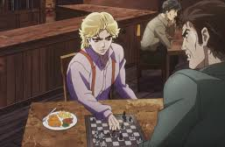
OUTLINE of the presentation
What is a chess engine
How chess engines work
Chess engine strength
World computer chess championship
Chess engines today
Kasparov vs. THE WORLD

Slide 3
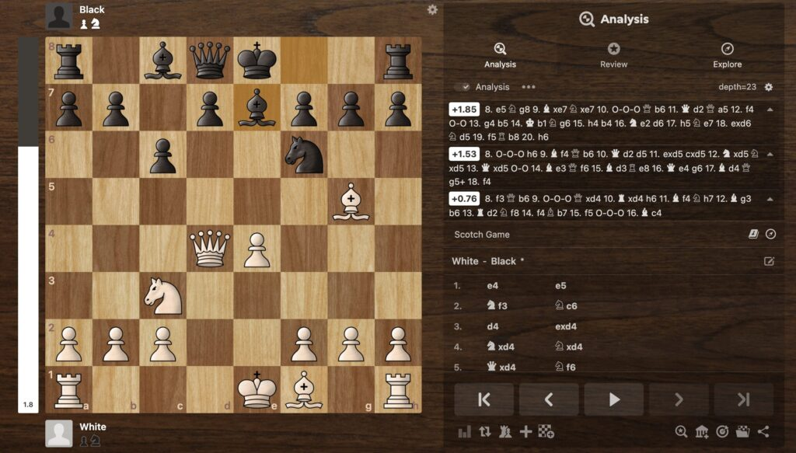
What is a chess engine?
Currently software, in history hardware
Analysis of chess variant positions
Generation of predicted strongest move
Use-case: training, analysis, cheating detection

Slide 4
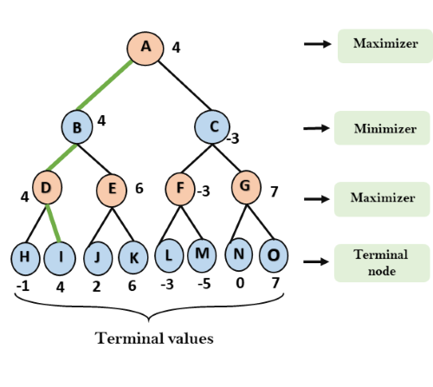
How chess engines work
Decision tree from possible moves
Aplha-beta pruning of branches
Minimax algorithm
Evaluation function: material, aktivity, position
Classical engines: Stockfish
Neural network engines: AlphaZero

Slide 5
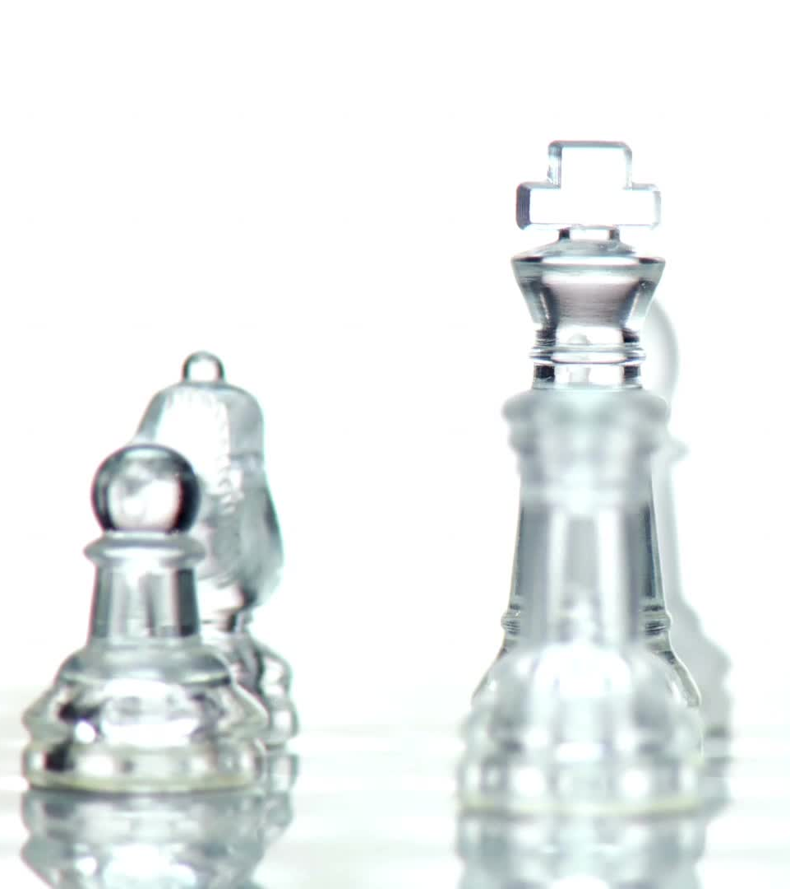
CHESS ENGINE STRENGth
Measured by ELO: official chess rating
1997: Deep Blue defeated Garry Kasparov
Top chess engines: 3500-3800 ELO
Dependent on hardware
Dependent on available databases

Slide 6
World computer chess championship
An international tournament for chess programs
Heavily dependent on hardware
World Chess Software Championship
1974 till today
Notable winners:
Cray Blitz: pure hardware victory
Deep Thought: precursor of Deep Blue, grandmaster level
Shredder: first widely user engine, balanced
Junior: agressive style

Slide 7
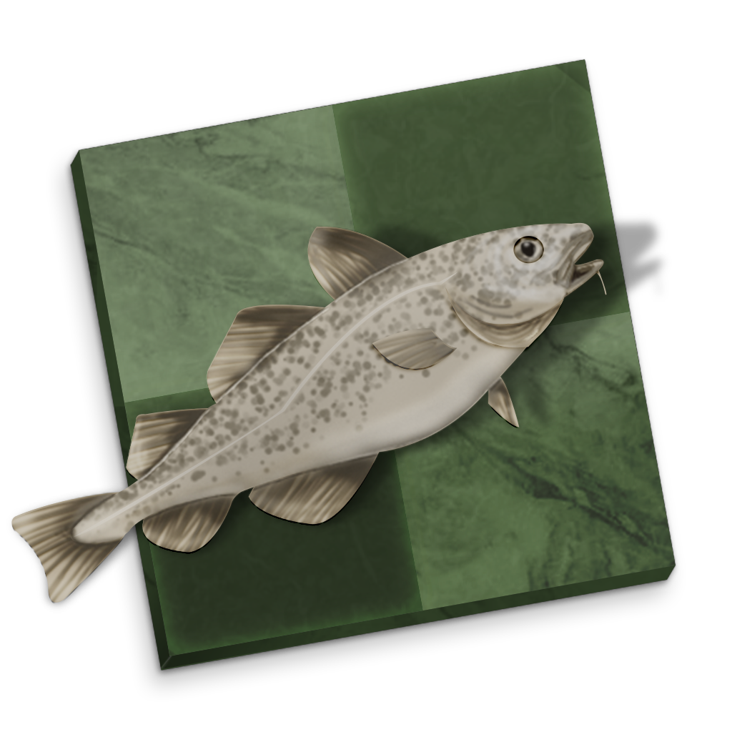
Chess engines today
Hybrid aproach: move databases, brute-force search, neural networks
Gukesh Dommaraju: 2732
Magnus Carlsen: 2840
Stockfish: open-source
Extremely fast, accurate

Slide 8
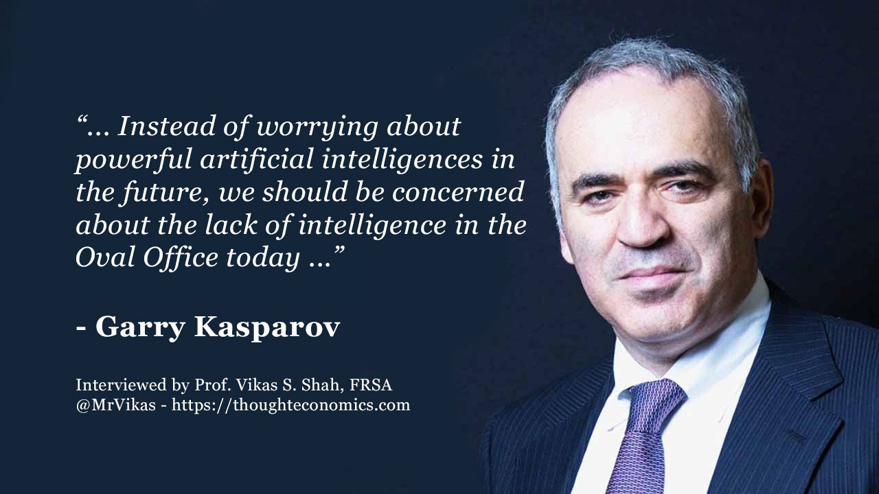
Kasparov vs. The world
1999
Chess engine assistance
1 vs. 50 000
Forced checkmate in 28 moves

Slide 9

Thank you for your attention

